Slide 1
Spectrum of discrete samples
Sampling may be useful in real-time (on the fly) transmission of multi-source signals over a single channel using time-division multiplexing (TDM). In this case, sampling interval (sampling rate) is maintained.

Slide 2
Spectrum of discrete samples
For digital storage and other digital transmission systems generally we have only a pool of discrete samples, arranged in sequence.
During playback/display the sample instants are decided as per the header information and/or system requirement.
So, digital signal in general is expressed as a function of sample number n only (not time t anymore).
That is, sample x(nT_{s}) is now given simply as x[n].
So, the timing information between samples is lost in case of digital signal.
That is, we only have the sample sequence numbers in hand and not the time instants of the samples.

Slide 3
Spectrum of discrete samples
Accordingly, now we will say Sampling interval = 1 sample (not T_{s} anymore).
Consequently, periodicity of a digital signal can be expressed only in terms of samples (not in terms of time) after which the sequence repeats, say N samples.
Likewise, frequency of a digital signal can be expressed as Ω = 2π / N radians per sample or simply radians (not in terms of hertz (Hz) or radian per second).
Now, let us find out how this frequency Ω of the digital signal is related to the frequency f or ω of the original analog signal from which this digital signal is supposed to have been derived by sampling (for simplicity, consider single-tone analog signal x(t) = A cos(2πft) has been sampled).

Slide 4
Spectrum of discrete samples
Suppose the samples are arranged in time with T_{s} time interval between samples (as one will obtain after sampling the original time-continuous signal).
Then the corresponding frequency
So, Ω can be related to f or ω as
This f / f_{s} is the normalized frequency, normalized w.r.t. the sampling frequency f_{s}.

Slide 5
Spectrum of discrete samples
So, 2π times of the normalized frequency is the corresponding frequency Ω in the digital domain when a continuous-time signal is discretized in time.
That means, normalized sampling rate = 2π radian.
Therefore, the spectrum of a digital signal described by a pool of samples is given by the same spectrum of the sampled signal but as a function of Ω (instead of ω or f).

Slide 6
Spectrum of discrete samples
The spectrum will repeat after every 2π radian.
So, it is good enough to view only one period of this periodic spectrum.
Accordingly, the spectrum is generally sketched from −π radian to +π radian or from 0 to 2π radian.
−π radian to +π radian corresponds to the spectrum from −f_{s} / 2 to +f_{s} / 2 or from − ω_{s} / 2 to + ω_{s} / 2
f_{s} Hz (or ω_{s} = 2πf_{s} radian/sec) corresponds to 2π radian.
Parts of spectrum beyond −f_{s} / 2 and +f_{s} / 2 are repetition of the same → as expected for angular frequency – repetition after every 2π radian.

Slide 7
Frequency normalization
Now, let us see the significance of this frequency normalization in case of digital signal.
Let a signal x(t) with spectrum X(ω), bandlimited in the range |ω| < ω_{m}, is sampled at Nyquist rate 2f_{m} Hz.
The spectrum of the sampled signal will be then 2f_{m}X(ω) repeated after every 2ω_{m}.

Slide 8
Frequency normalization
Now, say the signal is time-scaled to x(at) with spectrum X(ω/a)/a, bandlimited in the range |ω| < aω_{m},
This is sampled at Nyquist rate 2af_{m} Hz (a times the earlier sampling rate).
The spectrum of this sampled signal will be then 2f_{m}X(ω/a) repeated after every 2aω_{m}.

Slide 9
Frequency normalization (contd.)
It can be easily checked that the sets of samples obtained in both cases are exactly same.
So, the spectrum of the digital signal should also be identical.
This will require normalization of the frequency.
Frequency normalization by dividing the frequency axis by the sampling rate in each case will give same plot for the spectrum in both cases repeated after 2π radians.

Slide 10
What we have studied till now
Digitization of continuous-time (analog) signal:
3 steps – sampling, quantization and encoding
Quantization cannot be reversed and so introduces quantization noise – more number of quantization levels, smaller quantization intervals result in less noise but more bits
Signal recovery from samples, sampling theorem, Nyquist rate, aliasing problem, etc.

Slide 11
What we have studied till now
Frequency in digital domain for digital signal
Relation with frequency of the corresponding analog signal – frequency normalization
Range for spectrum representation in digital domain from −π to +π or 0 to 2π
How frequency normalization helps in consistency in digital signal spectrum:
x(t) sampled at f_{s} → x₁[n]
➔ x₁[n] = x₂[n] ➔ same digital spectrum
x(at) sampled at af_{s} → x₂[n]

Slide 12
Nature of spectrum
Nature of the Signal | Periodic Signal | Non-periodic Signal
Continuous-time Signal (Analog Signal) | Non-Periodic | Non-Periodic
Discrete-time Signal (Digital Signal) | Periodic | Periodic
FS
FT
Discrete-freq.
Cont.-freq.
DTFS
DTFT
Discrete-freq.
Cont.-freq.

Slide 13
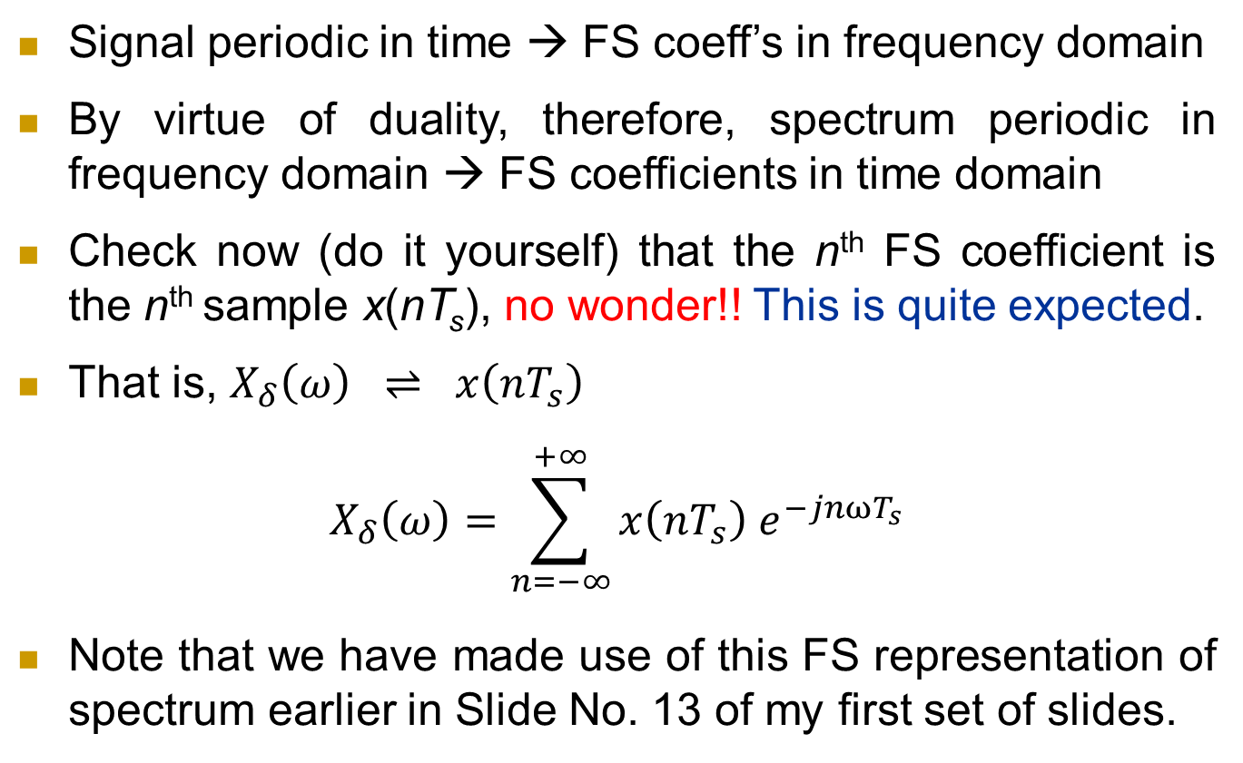
FS representation of the spectrum
Signal periodic in time → FS coeff’s in frequency domain
By virtue of duality, therefore, spectrum periodic in frequency domain → FS coefficients in time domain
Check now (do it yourself) that the n^{th} FS coefficient is the n^{th} sample x(nT_{s}), no wonder!! This is quite expected.
That is, $X_{δ}\left(ω\right) ⇌ x\left(nT_{s}\right)$
$$X_{δ}\left(ω\right)=\sum_{n=−∞}^{+∞}{x\left(nT_{s}\right) e^{−jnωT_{s}}}$$
Note that we have made use of this FS representation of spectrum earlier in Slide No. 13 of my first set of slides.

Slide 14
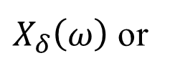
Discrete time Fourier transform
DTFT is used to obtain the spectrum of a signal discretized in time.
Recall FS representation of the spectrum for a sampled signal.
Periodicity = sampling frequency.
FS coefficients = sample values.
We may write
And we have
$X_{δ}\left(ω\right)$ or

Slide 15
Discrete time Fourier transform
Then we can write the expression for the spectrum as
This is the expression for DTFT.
Calculated for non-periodic discrete-time signal (since we have considered the corresponding analog signal to be non-periodic with continuous-frequency spectrum).
Since, we have continuous-frequency spectrum in analog domain, spectrum in digital domain also contains continuum of frequencies – i.e., continuous function of Ω.

Slide 16
Discrete time Fourier transform
In general, the discrete-time signal spectrum actually extends from Ω = −∞ to Ω = +∞ (as frequency f or ω extends from −∞ to +∞ in analog domain; Ω = ω / f_{s} )
But, as we have discussed earlier, the discrete-time signal spectrum repeats after every 2π and we sketch the spectrum only for −π to +π or 0 to 2π
In line with this, while continuous-time FT is non-periodic, DTFT is periodic function in Ω with period 2π (prove it yourself from the expression of DTFT).
Accordingly, DTFT is defined only for Ω = −π to Ω = +π

Slide 17
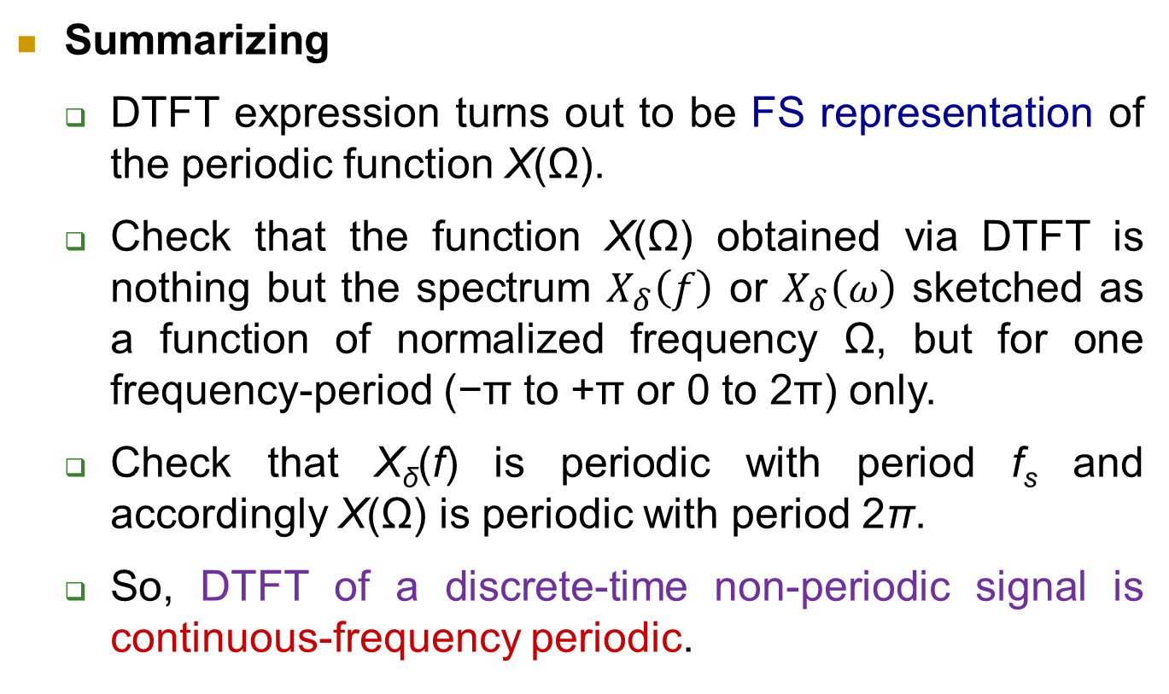
Discrete time Fourier transform
Summarizing
DTFT expression turns out to be FS representation of the periodic function X(Ω).
Check that the function X(Ω) obtained via DTFT is nothing but the spectrum $X_{δ}\left(f\right)$ or $X_{δ}\left(ω\right)$ sketched as a function of normalized frequency Ω, but for one frequency-period (−π to +π or 0 to 2π) only.
Check that X_{δ}(f) is periodic with period f_{s} and accordingly X(Ω) is periodic with period 2π.
So, DTFT of a discrete-time non-periodic signal is continuous-frequency periodic.

Slide 18
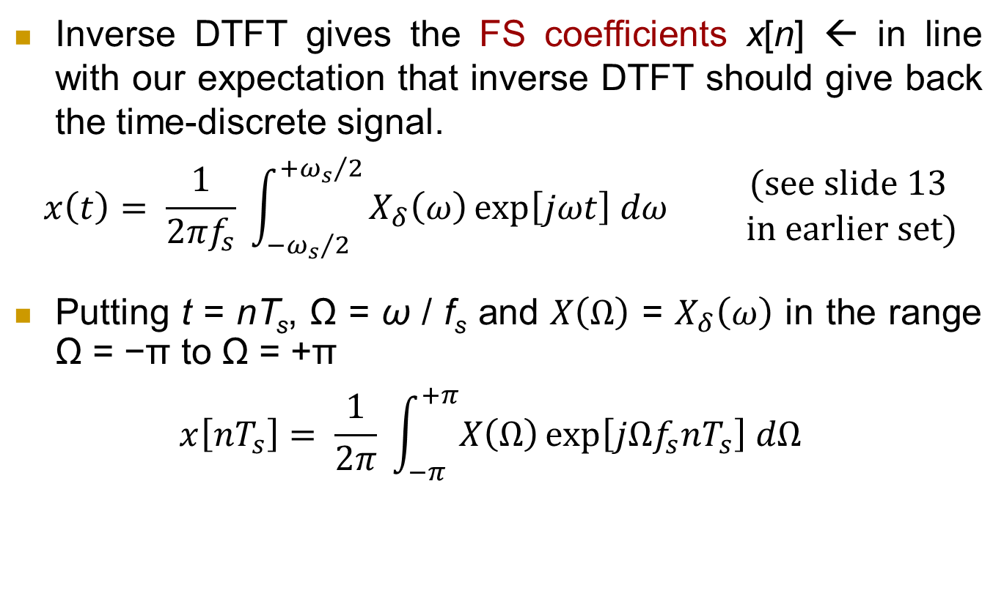
Inverse DTFT
Inverse DTFT gives the FS coefficients x[n] ← in line with our expectation that inverse DTFT should give back the time-discrete signal.
$$x\left(t\right)= \frac{1}{{2πf}_{s}} \int_{−{ω_{s}}/2}^{+{ω_{s}}/2}{X_{δ}\left(ω\right)\exp\left[jωt\right] dω \begin{matrix}(see slide 13 \\ in earlier set)\end{matrix} }$$
Putting t = nT_{s}, Ω = ω / f_{s} and $X\left(Ω\right)$ = $X_{δ}\left(ω\right)$ in the range Ω = −π to Ω = +π
$$x\left[nT_{s}\right]= \frac{1}{2π} \int_{−π}^{+π}{X\left(Ω\right)\exp\left[jΩf_{s}nT_{s}\right] dΩ }$$

Slide 19
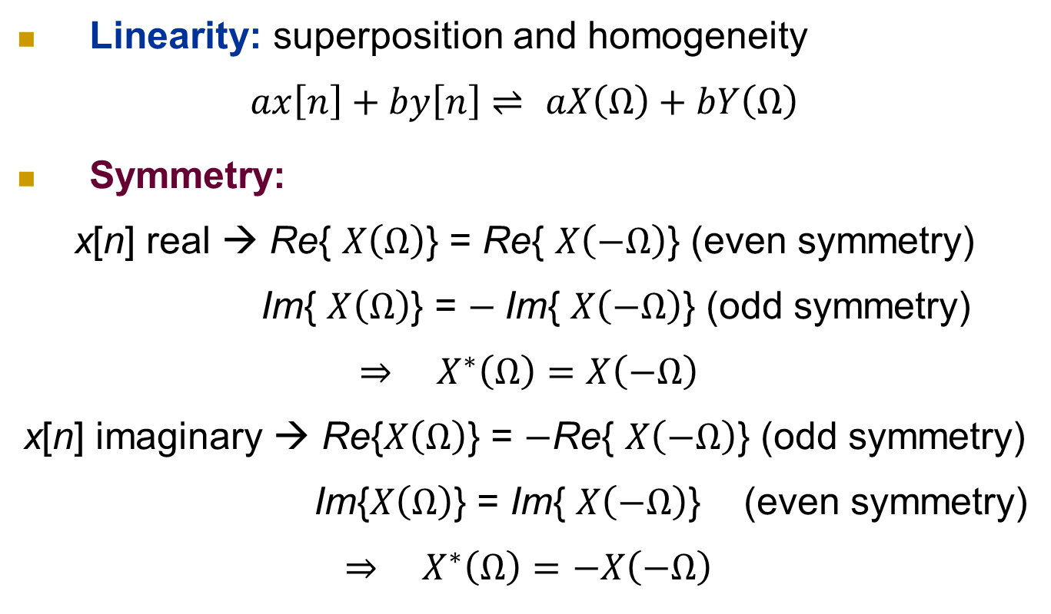
Properties of DTFT
Linearity: superposition and homogeneity
$ax\left[n\right]+by\left[n\right]⇌$ $aX\left(Ω\right)+bY\left(Ω\right)$
Symmetry:
x[n] real → Re{ $X\left(Ω\right)$} = Re{ $X\left(−Ω\right)$} (even symmetry)
Im{ $X\left(Ω\right)$} = $−$Im{ $X\left(−Ω\right)$} (odd symmetry)
$${ ⇒ X}^{∗}\left(Ω\right)=X\left(−Ω\right)$$
x[n] imaginary → Re{$X\left(Ω\right)$} = $−$Re{ $X\left(−Ω\right)$} (odd symmetry)
Im{$X\left(Ω\right)$} = Im{ $X\left(−Ω\right)$} (even symmetry)
$${ ⇒ X}^{∗}\left(Ω\right)=−X\left(−Ω\right)$$

Slide 20
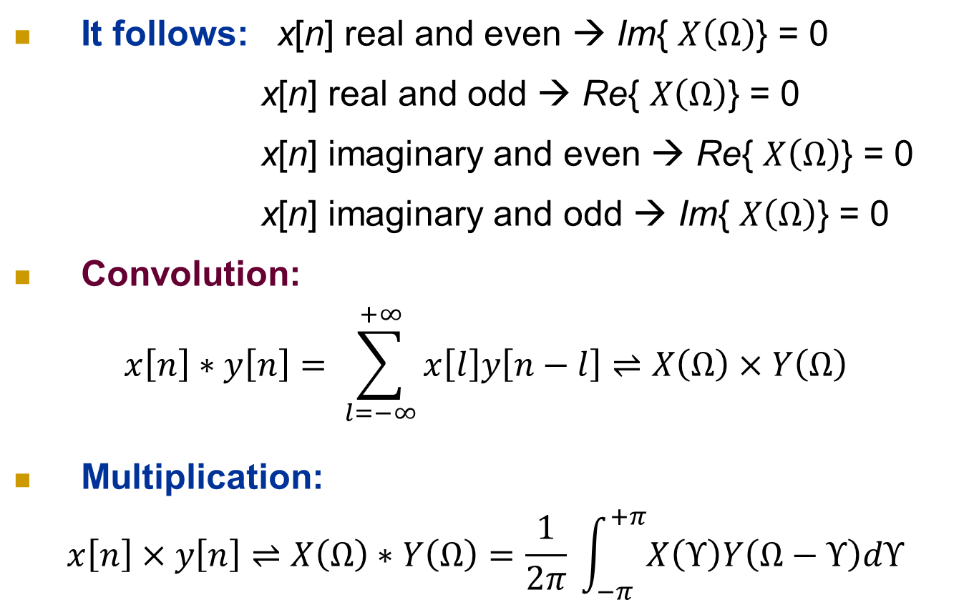
Properties of DTFT
It follows: x[n] real and even → Im{ $X\left(Ω\right)$} = 0
x[n] real and odd → Re{ $X\left(Ω\right)$} = 0
x[n] imaginary and even → Re{ $X\left(Ω\right)$} = 0
x[n] imaginary and odd → Im{ $X\left(Ω\right)$} = 0
Convolution:
$$x\left[n\right]∗y\left[n\right]= \sum_{l=−∞}^{+∞}{x\left[l\right]y\left[n−l\right]}⇌X\left(Ω\right)×Y\left(Ω\right)$$
Multiplication:
$$x\left[n\right]×y\left[n\right]⇌X\left(Ω\right)∗Y\left(Ω\right)=\frac{1}{2π} \int_{−π}^{+π}{X\left(Υ\right)Y\left(Ω−Υ\right)dΥ}$$

Slide 21
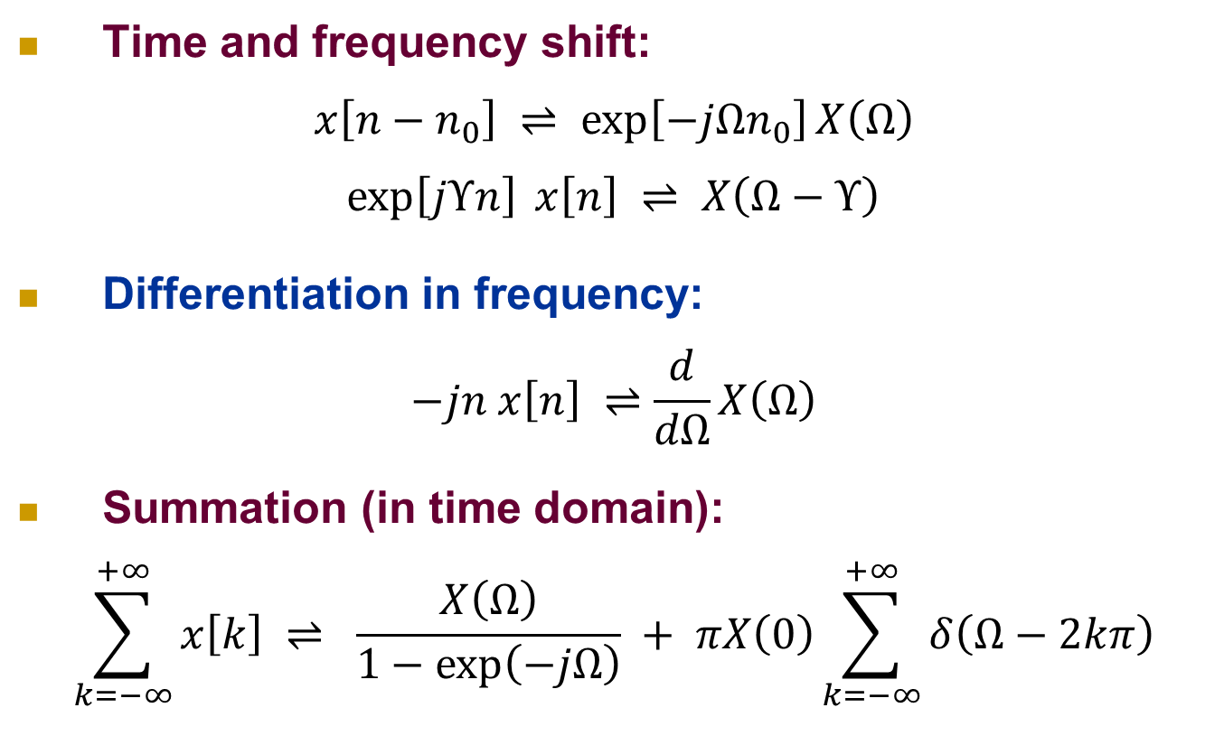
Properties of DTFT
Time and frequency shift:
$$x\left[n−n_{0}\right] ⇌\exp\left[−jΩn_{0}\right]X\left(Ω\right)$$
$$\exp\left[jΥn\right] x\left[n\right] ⇌ X\left(Ω−Υ\right)$$
Differentiation in frequency:
$$−jn x\left[n\right] ⇌\frac{d}{dΩ}X\left(Ω\right)$$
Summation (in time domain):
$$\sum_{k=−∞}^{+∞}{x\left[k\right]} ⇌ \frac{X\left(Ω\right)}{1−\exp\left(−jΩ\right)} + πX\left(0\right)\sum_{k=−∞}^{+∞}{δ\left(Ω−2kπ\right)}$$

Slide 22
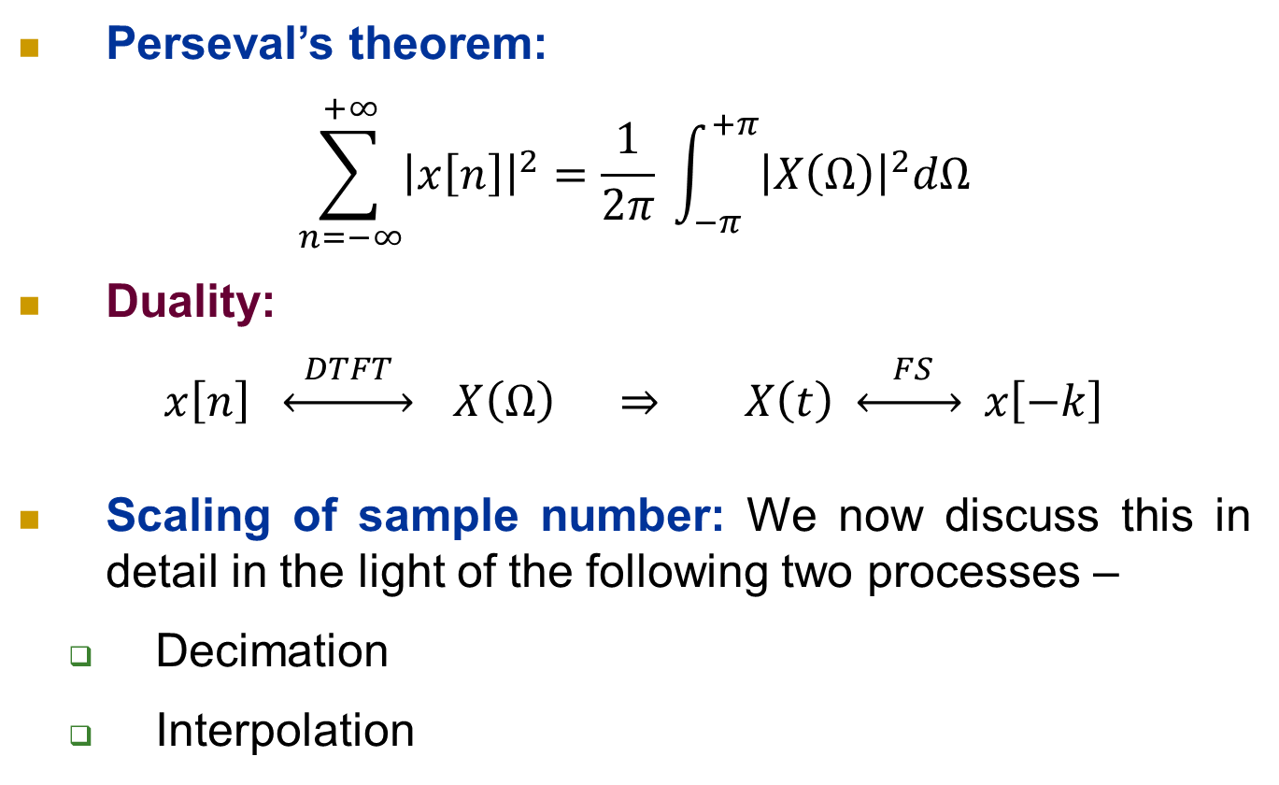
Properties of DTFT
Perseval’s theorem:
$$\sum_{n=−∞}^{+∞}{{\left|x\left[n\right]\right|}^{2}}=\frac{1}{2π} \int_{−π}^{+π}{{\left|X\left(Ω\right)\right|}^{2}dΩ}$$
Duality:
$x\left[n\right] \underset{↔}{ DTFT }$ $X\left(Ω\right) ⇒ X\left(t\right) \underset{↔}{ FS } x\left[−k\right]$
Scaling of sample number: We now discuss this in detail in the light of the following two processes –
Decimation
Interpolation

Slide 23
Decimation
M
x[n]
y_{D}[n]
Only every M-th samples are taken while others are dropped
Essentially integral scaling in time domain by a factor M.
As if the signal is compressed along time axis by M times, but sampled at same rate.
Process called downsampling or decimation.

Slide 24
Decimation (contd.)

Slide 25
Decimation (contd.)

Slide 26
Interpolation
L
x[n]
y_{I}[n]
Essentially scaling in time domain by a factor 1/L where L is an integer.
Samples are spaced by L times more (as if the signal is stretched along time axis by L times) with missing samples in-between padded (interpolated) with zeroes.
Process called expansion, upsampling or interpolation.

Slide 27
Interpolation (contd.)

Slide 28
Interpolation filter
Interpolation generates images of the signal spectrum as seen before.
Interpolation filter – Low Pass digital filter with cutoff frequency π/L that follows the interpolator to suppress all images.

Slide 29
Interpolation filter
Check that the output of interpolation filter is what we would have got by sampling the original time-continuous signal at a rate L times more.
So, interpolation filter essentially recovers actual signal samples at L − 1 in-between points that are zero-padded (no wonder, it is quite possible).

Slide 30
In short…….
Interpolation is increasing the sampling rate by an integral factor L.
This may be done by inserting extra L − 1 samples in between every pair of input samples.
But, values of these sample (in the original continuous-time signal) are not available in the input digital signal.
So, in the first place we take these sample values as zero.
Following this, an interpolation filter retrieves these sample values.
Since here sampling rate is increased there is no question of aliasing.

Slide 31
In short…….
Decimation / interpolation are used for changing sampling rate –
Decimation reduces sampling rate.
Interpolation (with digital interpolation filter) increases sampling rate.
Generate a new digital signal directly from the input digital signal without the need for intermediate reconstruction of the original continuous-time signal.
That is, change the input set of samples to a new set of samples that would have been obtained if the original continuous-time signal was sampled at the modified sampling rate.

Slide 32
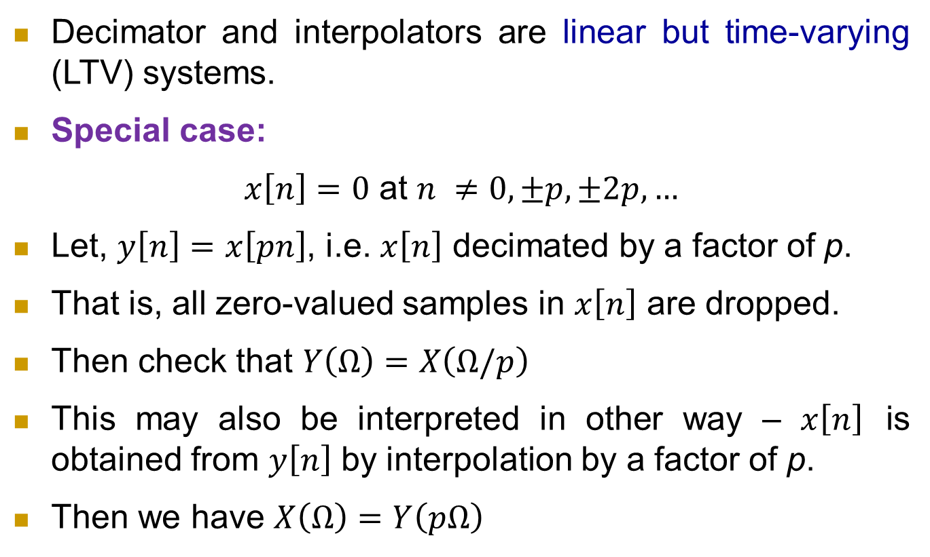
In short…….
Decimator and interpolators are linear but time-varying (LTV) systems.
Special case:
$x\left[n\right]=0$ at $n ≠0, ±p, ±2p, …$
Let, $y\left[n\right]=x\left[pn\right]$, i.e. $x\left[n\right]$ decimated by a factor of p.
That is, all zero-valued samples in $x\left[n\right]$ are dropped.
Then check that $Y\left(Ω\right)=X\left(Ω/p\right)$
This may also be interpreted in other way – $x\left[n\right]$ is obtained from $y\left[n\right]$ by interpolation by a factor of p.
Then we have $X\left(Ω\right)=Y\left(pΩ\right)$

Slide 33
Decimation and interpolation
Interpolation results in compression of spectrum by L times without any overlapping (no aliasing).
Decimation results in stretching of spectrum by M times and may result in aliasing.
Fractional decimation scheme: achieved by interpolation followed by decimation
L
H(z)
M
x[n]
y_{I}[n]
y₂[n]
y [n]
Interpolation Filter
Decimation factor = M/L, Sampling rate increased by factor L/M
Example: speech signal 24 kHz to 18 kHz with L = 3, M = 4

Slide 34
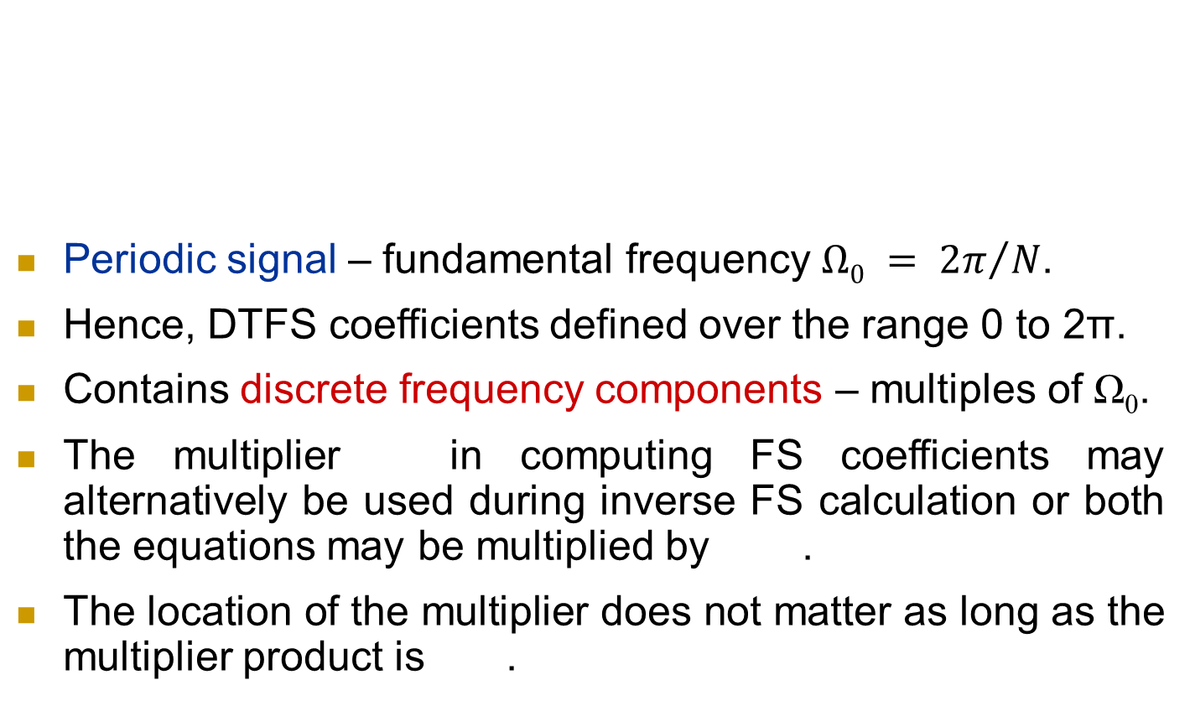
Discrete time Fourier series
Periodic signal – fundamental frequency $Ω0 = {2π}/N$.
Hence, DTFS coefficients defined over the range 0 to 2π.
Contains discrete frequency components – multiples of Ω₀.
The multiplier in computing FS coefficients may alternatively be used during inverse FS calculation or both the equations may be multiplied by .
The location of the multiplier does not matter as long as the multiplier product is .

Slide 35
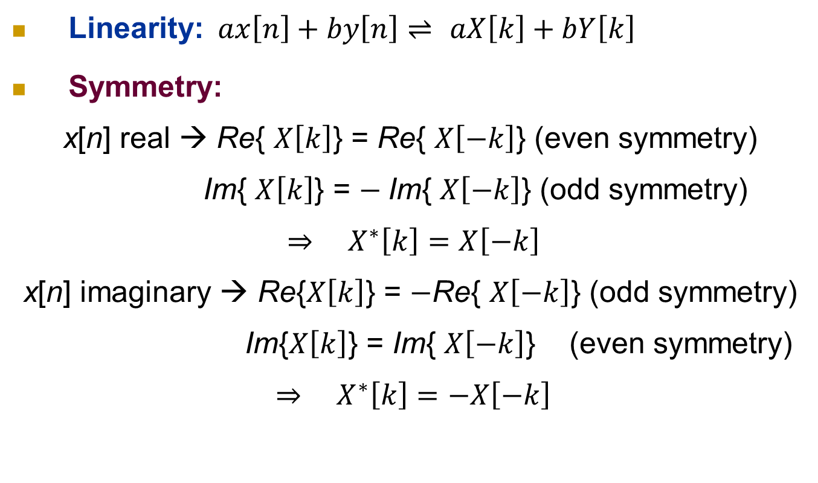
Properties of DTFS
Linearity:$ax\left[n\right]+by\left[n\right]⇌$ $aX\left[k\right]+bY\left[k\right]$
Symmetry:
x[n] real → Re{ $X\left[k\right]$} = Re{ $X\left[−k\right]$} (even symmetry)
Im{ $X\left[k\right]$} = $−$Im{ $X\left[−k\right]$} (odd symmetry)
$${ ⇒ X}^{∗}\left[k\right]=X\left[−k\right]$$
x[n] imaginary → Re{$X\left[k\right]$} = $−$Re{ $X\left[−k\right]$} (odd symmetry)
Im{$X\left[k\right]$} = Im{ $X\left[−k\right]$} (even symmetry)
$${ ⇒ X}^{∗}\left[k\right]=−X\left[−k\right]$$

Slide 36
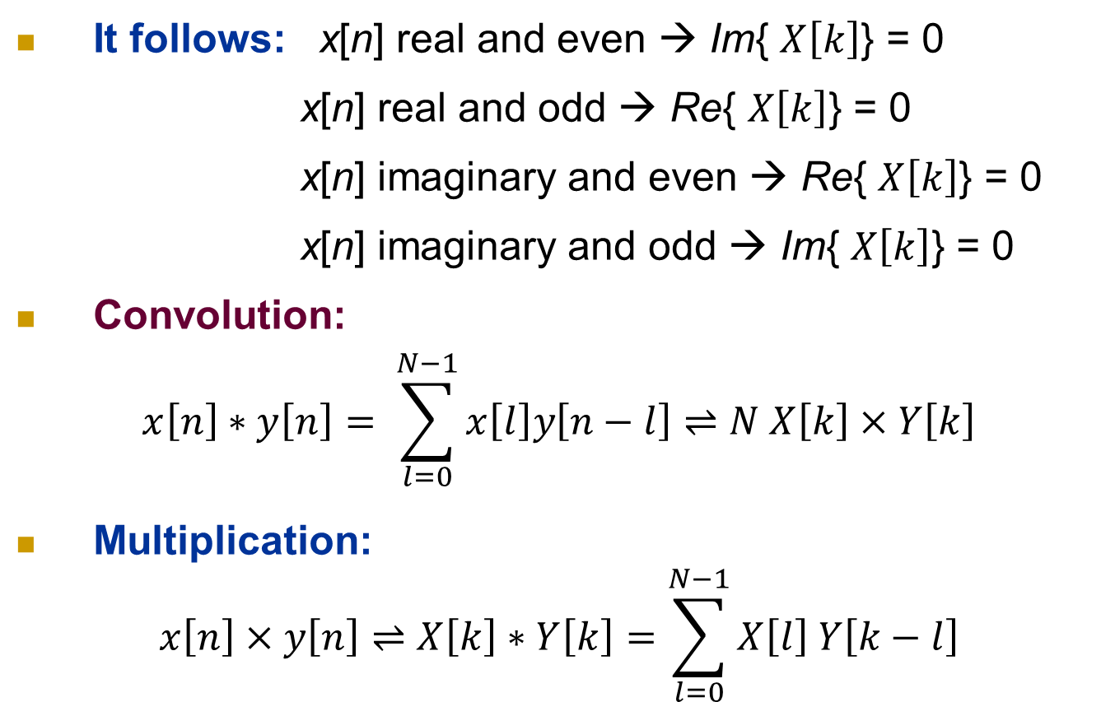
Properties of DTFS
It follows: x[n] real and even → Im{ $X\left[k\right]$} = 0
x[n] real and odd → Re{ $X\left[k\right]$} = 0
x[n] imaginary and even → Re{ $X\left[k\right]$} = 0
x[n] imaginary and odd → Im{ $X\left[k\right]$} = 0
Convolution:
$$x\left[n\right]∗y\left[n\right]= \sum_{l=0}^{N−1}{x\left[l\right]y\left[n−l\right]}⇌N X\left[k\right]×Y\left[k\right]$$
Multiplication:
$$x\left[n\right]×y\left[n\right]⇌X\left[k\right]∗Y\left[k\right]=\sum_{l=0}^{N−1}{X\left[l\right] Y\left[k−l\right]}$$

Slide 37
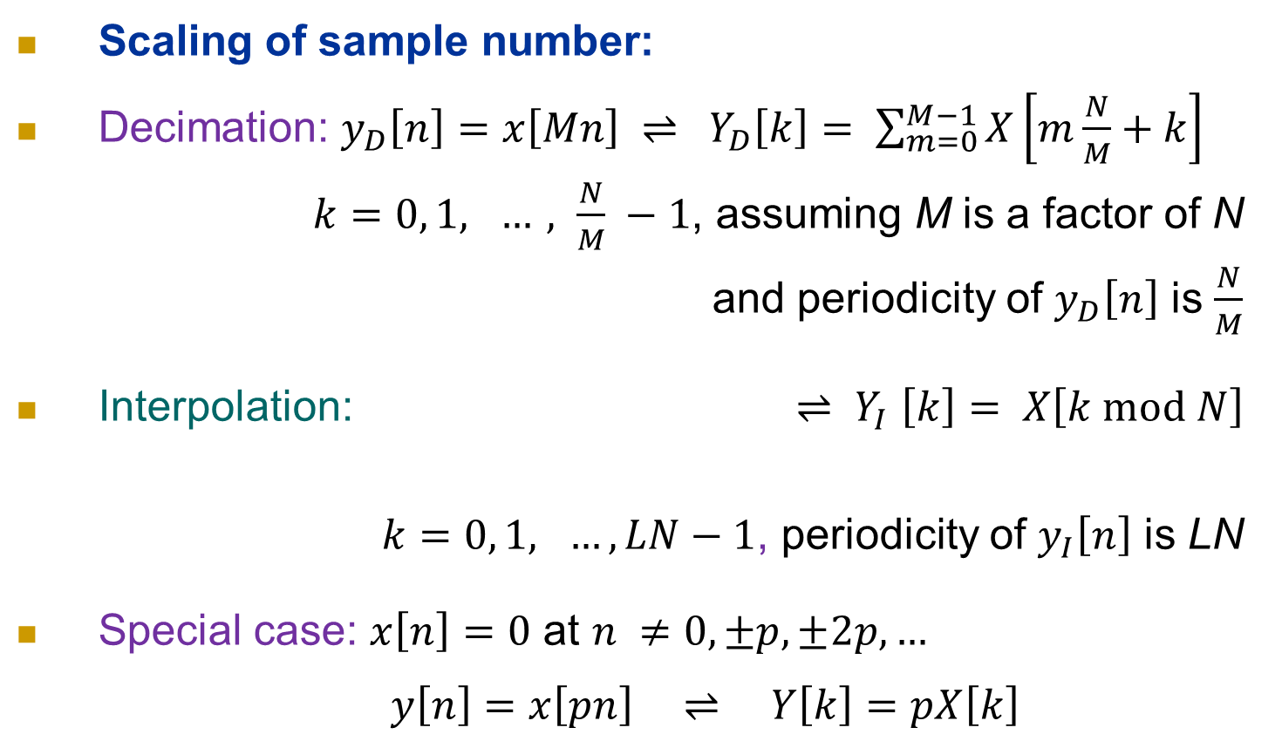
Properties of DTFS
Scaling of sample number:
Decimation: $y_{D}\left[n\right]=x\left[Mn\right] ⇌ Y_{D}\left[k\right]= \sum_{m=0}^{M−1}{X\left[m\frac{N}{M}+k\right]}$
$k=0, 1, …, \frac{N}{M} −1$, assuming M is a factor of N
and periodicity of $y_{D}\left[n\right]$ is $\frac{N}{M}$
Interpolation: ${⇌ Y}_{I}\left[k\right]= X\left[k mod N\right]$
$k=0, 1, …, LN−1$, periodicity of $y_{I}\left[n\right]$ is LN
Special case: $x\left[n\right]=0$ at $n ≠0, ±p, ±2p, …$
$y\left[n\right]=x\left[pn\right] ⇌ Y\left[k\right]=pX\left[k\right]$

Slide 38
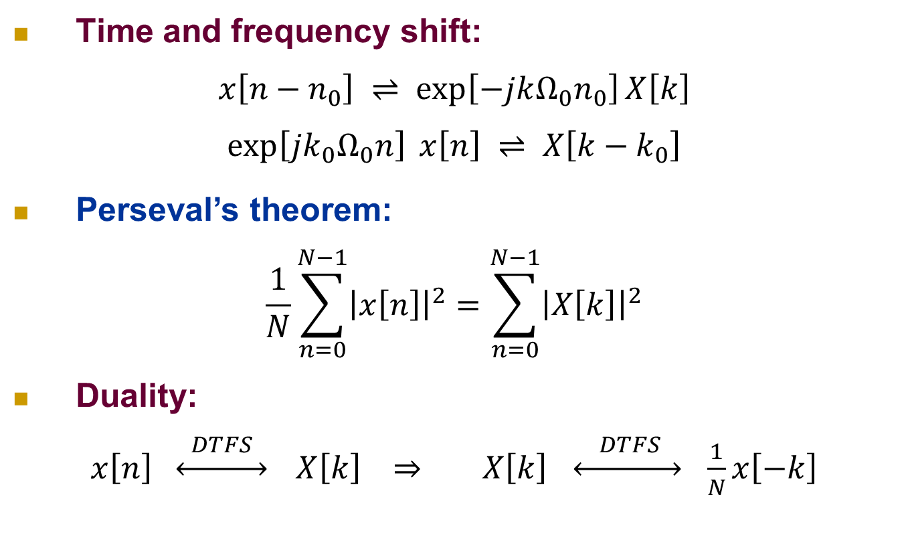
Properties of DTFS
Time and frequency shift:
$$x\left[n−n_{0}\right] ⇌\exp\left[−jkΩ_{0}n_{0}\right]X\left[k\right]$$
$$\exp\left[jk_{0}Ω_{0}n\right] x\left[n\right] ⇌ X\left[k−k_{0}\right]$$
Perseval’s theorem:
$$\frac{1}{N}\sum_{n=0}^{N−1}{{\left|x\left[n\right]\right|}^{2}}=\sum_{n=0}^{N−1}{{\left|X\left[k\right]\right|}^{2}}$$
Duality:
$x\left[n\right] \underset{↔}{ DTFS }$ $X\left[k\right] ⇒ X\left[k\right] \underset{↔}{ DTFS } \frac{1}{N}x\left[−k\right]$

